Slide 1
HPM Platform
Heiler Product Manager Software Platform

Slide 2
What is HPM (technical definition)
Heiler Product Manager - Product Information Management (PIM) solution
Is a client-server system used to import, store, manage and export information about products
Provides rich user interfaces based on desktop client
Provides integration interfaces with other systems
Highly customizable on technical and business level
Optimized for large data volumes

Slide 3
HPM Platform
HPM platform is a custom application server and client technology developed by Heiler Software AG
Uses Model-driven engineering concept
Supports customizable business models
Uses domain meta models in runtime as opposite to code generation approach
Transparent client-server communication, shared services
Provides all necessary components to build enterprise level data management applications
Over 10 years old. Constantly evolving.
Client side is based on Eclipse RCP and OSGi
Rich GUI. Customizations of any kind
Server side is based on OSGi technology with eclipse extension registry
OSGi supports software components dependency management
Extension registry provides infrastructure for customizings and plugins
Client-server communication is based on a custom communication framework – p2p communication bus
Features: multi-server, load balancing, transparent client-server communication

Slide 4
HPM Platform – the true challenge
Is a base for different business and domain models
Many layers of abstraction
Extensibility and customization on all levels
Complex data models
“Fat” client
A lot of public API
API backward compatibility
Running by many customers
About 10 years old and counting

Slide 5
HPM Functional Layers
HPM Application
Business model: items, catalogs, classification structures, attributes, prices, descriptions etc.. Custom presentation logic. Business logic.
HPM Platform
Data access, application infrastructure, application services, Client GUI
Data generic import
Data generic export
Data generic merge
User tasks

Slide 6
HPM Platform layers
Data management
The core of the HPM platform.
Provides business data objects lookup and modification services.
Infrastructure services
Cross-cutting frameworks and services required by all components (security, extension registry, communication framework, etc.)
Application services
Standard application services which can be used by business logic (jobs, workflows, webservices integration, etc)
GUI
Graphical user interface framework. Based on eclipse RCP platform. Very flexible and provides numerous extension points.

Slide 7
Platform components
Domain model repository
Data access engine
Data Security
Data navigation
Command framework
Data Search
Data models
Audit
RCP (Eclipse)
I18N
Preferences
Communication bus
Caching
Domain model UI elements
XML serialization
Logging
Lifecycle management
Workflow engine (JBPM)
Extensions framework (Eclipse)
Web-services integration
Mass data processor
Servlet container
Mail service
Security
Monitoring
App Logging
File transfer
Job framework
System jobs
Data layer
Infrastructure
Application services
GUI

Slide 8
The HPM Architectural Principle
Generic Import Logic
Mapping from external data
Domain Entity Data
Domain Entity Data
Domain model
Any custom Generic Logic
Domain Entity Data
Structure
Persistence meta data
Any custom meta data
New data management / access approach
Generic Persistence Logic
Validation meta data
Security meta data
Presentation meta data
Query meta data
Entity Data Presentation
Render
Storage
Generic UI Logic
Access data
Domain Entity Data

Slide 9
The HPM Architectural Principle
HPM application is built around domain model
Domain model has a structure definition and is enriched with custom metadata
Application functional layers are implemented in a generic way and can work with any domain model. Domain model is „interpreted“ or processed in run-time using respective metadata.
Advantages:
Domain model structure can be changed without changing the logic
New functional layers can be added without altering the existing ones

Slide 10
HPM Distributed Platform
HPM Platform is distributed and supports multiple clients servers.
HPM communication framework is a communication bus of the platform.
Core – is a part of the application and platform logic which is deployed on the server and client sides (shared logic).
Client context
Client
Core
Server
Communication bus
(HPM communication framework)
Server context

Slide 11
HPM Platform technology stack
Java 6
OSGi equinox
Eclipse RCP
Eclipse Modeling Framework (EMF)
Service Data Objects (SDO)
Hibernate/JPA, JDBC
Webservices (Axis2 , REST JAX-RS)
JBPM (Workflows)
Servlets (Jetty)
Apache commons
Quartz
EHCache
Oracle 10g, 11g
MS SQL Server 2005, 2008

Slide 12
Platform components
Data layer

Slide 13
Data layer (I)
Domain model repository
Defines domain model structure: entities, attributes, relations.
Defines meta information needed for domain objects presentation, persistence, validation, audit, security.
Defines types of logical filters (logical keys) for (sub)entity containers.
Can be modified by non-developer.
Is a run-time model - no code generation is performed using the model.
Data models
Detail model – runtime container for a single business entity including its containments (sub-entities)
List model – read-only table container for large sets of business entities which data graphs are projected on table rows.
Report – internal structure which represents a set of business entities IDs, produced by search query.
Entity Proxy – identity object for business entities
Data navigation
Utility objects and services used to define navigation paths and filters on graphs of business entities
Used in run-time by detail models and list models. Main elements: FieldPath, EntityPath, LogicalKey
Audit
Data modification audit. Can customized

Slide 14
Data layer (II)
Data access engine
Detail model objects operations: Create Read Update Delete (CRUD).
List model objects loading
Business entities change notifications
Transparently works on client and server side (same interfaces)
Command framework
Pluggable framework which is used to edit business entities.
Provides declarative extension points to hook any kinds of entity or entity fields modifications
Extensions are contributes pro field or entity using identifiers from repository.
Intended to be used for custom business logic implementations.
Data Security
Managed by Access Control Lists (ACL), Qualified Field Permissions, Action rights.
Data Search
Entity search framework: provides search expressions framework which can be used to define search conditions using entity field paths. Search query result is a list of entities IDs which satisfy given logical search criteria.
Reporting framework: provides services to run predefined search queries in a form of a DB stored procedure.

Slide 15
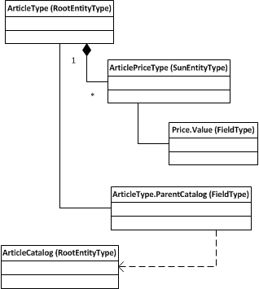
Domain Model Repository – meta model (EntityType)
Standard entity relation model (graph structure).
EntityType – business entity. Do not let ‘Type’ part mislead you, think about a EntityType as a business entity!
EntityTypes contain FieldTypes.
EntityTypes contain other entityTypes.
EntityTypes which do not have parent EntityTypes are called root entityTypes (not shown on the diagram).
EntityTypes which do have parent EntityTypes are called sub entityTypes (not shown on the diagram).
FieldTypes may reference other root EntityTypes (one-to-many relation).
Entity relation meta model:
Example:

Slide 16
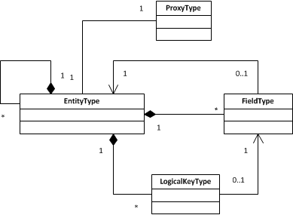
Domain Model Repository – meta model (Runtime Elements)
ProxyType – defines “identity” object for EntityType.
Proxy is a small lightweight object which contains values (ids) which uniquely identify business entity instance.
ProxyType defines proxy java class and information how to instantiate proxy in run-time (references to fieldTypes)
LogicalKeyType – defines parameter type of “logical filters” in entityType containers
Logical filter in the container constrict set of elements. You can think about it as a data dimension.
For example imagine a list of article descriptions in different languages, here language id defines a language dimension. LogicalKey, which points to language id fieldType defines a logical filter parameter type. EntitType may have many different logical key and respectively many dimensions.

Slide 17
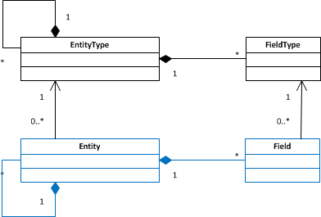
Domain Model Repository – meta model (Entity)
Repository entity element – façade of the EntityType
Entity delegates most of the business entity definition to EntityType
Every business entity is represented by entity element in the repository
Represents part of business entity definition which can be safely customized.
Example: set entity I18N label
Different entities may reference to the same EntityType
Example: PurchasePrice and SellingPrice are different entities but reference to the same ArticlePriceType

Slide 18
Domain Model Repository – meta model (Complete)
Complete Repository

Slide 19
Domain Model Repository – meta model (other elements)
Permissions
Defines permission types for entities
Enumerations
Domain model enumerations. Example: country codes.
Values can be hard-coded in the repository or populated in run-time using EnumerationValueProvider extensions.
Categories
For presentation only
Categories are used to group entity fields in the UI.
Logical keys for entities
Defines logical keys for entity elements. References the LogicalKeytTypes.
Logical key values can be hardcoded in the entity definition. In runtime it will work as a constant filter.

Slide 20
Attribute categories of the repository elements
General attributes
Identifiers, Data type, Object name
Presentation
I18N labels, documentation, UI elements references, UI label patterns
Security
Persistence
Attributes used to map fields and entities data to DB persistence models
Application
Meta data for import, export, user tasks
Constraints
Field values constraints used by validation framework
See repository documentation in SDK

Slide 21
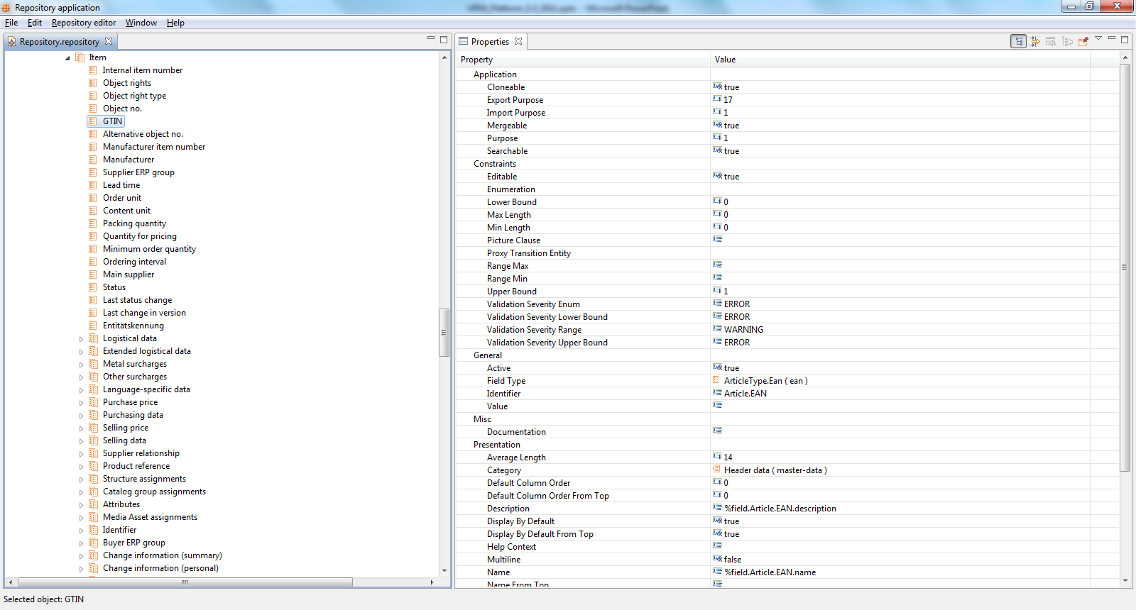
Repository
Repository is based on EMF technology and modeled using ECore model.
Visual editor is available as a standalone application
Repository model is stored in Repository.repository file in XML format.

Slide 22
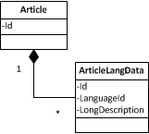
Data navigation
Generic navigation on entity data graphs in runtime
Example: in the article data graph navigate to the article long description in English
Navigation paths are defined on domain data model, but not on data instances.
Used on many places across platform: presentation, persistence, business rules, etc
Used by generic import and export modules to define data mappings
Navigation paths defined by EntityPath and FieldPath in terms of repository elements EntityType and FieldType
EntityPath has start EntityType and target EntityType
FieldPath consists of EntityPath and pointer to repository FieldType
1:n relations in the EntityPath are resolved using logical keys
To resolve ambiguity while navigating throw the container of elements you need to define values of logical keys of this container. Logical keys values shell be set on the enityPath object, it is called qualification. When all keys are set then entity path is full qualified.
Example: path to article long description text in English.
ArticleType -> (logicalKey.langugageId=7) -> ArticleLangData: LongDescriptionFieldType

Slide 23
Types of logical keys
Key which is mapped to a business field and this field can only take values from a predefined set - enumeration (example: language id)
Key which is mapped to a business field and a field value set is not predefined (example suppler id)
Key which value is a (irreversible) function of other field values (example: “valid at” price field)
Key mapped entity relation field (proxy field)
Combinations of these types are also possible

Slide 24
Data models – entity proxy
Entity proxy is lightweight immutable object which contains entity unique identification data
It is a reference to entity item.
Used in all data access methods and frameworks
Every root EntityType (and every Entity) has its own java implementation of a Proxy interface
Proxies usually contain internal identifier (id in the DB) and external identifier (String)
If only external identifier is set then the proxy is “transient” and may not represent existing item or represent entity which is not yet created.
Starting from HPM 6.0:
contains entity identifier
Cached in memory and can be resolved only by internal id and data source (database identifier)
Can be instantiated using EntityProxyFactory
Factory uses meta info from repository to instantiate java entity proxy objects
May contain parent entity proxy
Parent type depends on proxy implementation, not on domain model structure!

Slide 25
Data models – detail model
Detail model is a container for root entity item data graph. It contains the actual entity data.
Item data graph is a EMF based SDO object.
Supports platform-wide change notification and caching. Single instance for each entity.
On detail model save operations all clients and servers are notified.
Supports transactions using read and write locks inside one JVM.
Detail model and contained entity can be locked for writing while performing data change operations .
Objects are locked only inside one JVM.
Optimistic locking for several JVMs is used.
Entity field values can be read using FieldPaths.
Modifications shell be performed using Command Framework only.
Detail model instances are managed using EntityManagers.
Operations: load detail model by proxy, save, create new
Entity models are cached to reduce number of load requests
One entity manager instance pro EntityType defined in the repository.

Slide 26
Versioning
Platform supports root entity versioning on the business level. Entity versioning support is activated in the repository. All main entities in the standard repository support versioning.
Entity version is actually a entity branch (in SCM terms), but on business layer it is used only as a tag – read only branch.
Entity item may reference other items of the same version only (versions for the referenced items are automatically created if needed)
Version meta information is stored in the “Version” business entity.
Versions are referenced using VersionToken object – version id. Predefined version tokens:
VersionToken.NONE - versioning is not supported
VersionToken.HEAD – the “main” version
TBD: how to create a revision

Slide 27
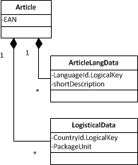
Data models – list model
List model is a read-only table container for large (millions of records) sets of business entities
Every column in the table is defined by a qualified FieldPath.
Every row is a flattened sub graph of a root entity.
Supports transitions, i.e. references to other root entities in the data graph.
Supports data virtual load (data lazy load)
Rows are loaded in blocks and only when they are really requested by a API consumer.
Items set can be defined by arbitrary list of ids.
EAN
Description (EN)
Unit (US)
Unit (DE)
…

Slide 28
Data models - report
Report is a persisted list of ids of root entities. Used to define entity set in list models.
Report can be created using following methods:
Execute HPM data search query (search expressions).
Executing a report query - predefined DB stored procedure.
Use existing array of ids
Report operations : intersect, subtract, copy, delete.
Reports are stored in the DB and are used to select data using SQL JOINs
Reports can be temporary or permanent. Temporary reports are regularly deleted from DB (every hour).
Since 5.3 it is recommend to use EntityItemSelection which wraps report and its id array.
Before 6.0 reports are managed using ReportUtils. Since 6.0 only ReportService shell be used.

Slide 29
Datamodel – report. JOIN
Report is a persisted and reusable result of a SQL ‘WHERE’ condition
Report Storage:
ItemId | ReportId
102432 | 101
10564 | 101
3426 | 101
347445 | 101
33356 | 101
… | 102
… | 102
… | …
… | …
Select A ...
…
…
…
…
…
…
…
Select B ...
…
…
…
…
…
…
…
Select C ...
…
…
…
…
…
…
…
JOIN
JOIN
JOIN

Slide 30
Data access engine
Access ListModel and DetailModel objects in the core contex (i.e. on server and client side)
Autimatically synchronize data modificatios across clients and servers
DetailModel data acccess cycle:
Create entity proxy using ProxyFactory or get proxy from list model row or use proxy lookup service (starting from 6.0)
Load detailModel by enityProxy (use sub entity filters if necessary)
Lock detailModel
Perform data modifications using command framework
Save detailModel
Unlock detailModel
Listmodel data access:
Create a report – selection of the desired root entities
Create listmodel settings: qualified fields, load sytle (virtual/non-virtual), etc
Load data using listModel loader
Iterate over listmodel rows

Slide 31
Data access engine – data synchronization

Slide 32
Data modification command framework
Pluggable framework which is used to edit business entities and contribute custom data logic
Provides several predefined workflows (called commands) for entity data modifications.
PutCommand, CreateCommand, AddCommand, RemoveCommand
Each command consists of operators (steps). Steps sequence and transision depends on command implementation.
Initializer, property validator, preSetter, setter, postSetter, remover, etc.
To customize commands (workflows) one can contribute operators for any repository Entiy, EntityType, Field or EntityFeild.
In run-time one can supply different callbacks – feedback processors. Feedback processor must react on validation warning/errors and fatal errors.
Examples: UI feedback processor – open warning dialog, logging feedback processor – write warning into logfile
Detailed documentation is available

Slide 33
Data modification command framework – PutCommand
PutCommand.create(…)
PutCommand.set(…)
PutCommand.put(…)

Slide 34
Data security – ACL, Field Pemissions, Action Rights
Access Controll List (ACL) – data access security for business object instances
Implementaion has been inspired by java security
Fine-grind: it is possible to define access permissions on a single business entity instance for a single user or group.
Standard permissions avaialbe:
FULL, DELETE, WRITE, READ
Field permissions and qualified field permissions. Rights defined on the repository elements
Action rights. Defines security rules for user UI actions.
Used in CommandFramework , Persistence Layer, UI.

Slide 35
Data search
Data search is used to find root entitys which sutisfy certain search createrias. Search result is usually backed by a report.
First approach: reporting framework – reports execution and management
Provides mechanisms to run predefined stored procedures and store results as a report.
Platform provides dozens of predefined stored procedures (i.e. search queries)
It is possible to use another report as a filter for stored procedures
Second approach: entity search framework – search expressions and search query execution engine
Generic framework to define logical search criterias in terms of EntityTypes, FieldTypes and logical keys.
Search query language
Can not search across different datasources (MAIN, MASTER, SUPPLIER)
Search query definitions are persistable

Slide 36
Data Audit
Platform provides hooks to audit data modifications
EntityAuditLog - high level asynchronous interface (deprecated)
Contributions are free to implement any kind of audit logic.
Persistence is not supported by platform
AuditLogProvider – synchronous interface to prepare audit log records
It is not audit log trail, i.e. it does not create modification history!
AuditLogProvider implementations must create or update logRecord.
It can be only one record pro entity!
Platform provides persistence logic for audit log records. Implemented by AuditLogWriter
Standard HPM AuditLogProvider
Record creation, modification or deletion timestamp and user id
Auditlog records are available in the business model

Slide 37
Main classes in the data access layer
EntityProxy, EntityDetialModel, Listmodel, EntityProxyFactory, EntityManager, ListModelLoader, ListModelSettings, ListModelSynchronizer, EnumerationProvider
ListEntry, ListColumn, ListEntry
EntityPath, FieldPath, LogicalKey,
Repository, RepositoryUtils, EntitType, FieldType
Command, FeedbackProcessor, CommandContext
Report, ReportResult, ReportQuery, ReportService
EntityProperty, EntityItem, ListModelQuery, ListModelProvider, ListModelQuery,EntityItemList, LogicalKeyEvaluator, QualificationElement, QualificationModel, VersionProxy, VersionToken, EDataGraph

Slide 38
Infrastructure services

Slide 39
Infrastructure components
Extensions framework
Communication framework
Components lifecycle management
Security and Authentication
Preferences and configuration
XML serialization
I18N
DB access
Caching
Logging
Monitoring
Packaging

Slide 40
Extensions framework – Eclipse extensions
HPM Platform and application extension mechanism is based on eclipse extension framework
Eclipse provides the concept of "extension points" and "extensions" to facilitate that functionality can be contributed to plugins by other plugins.
Plugins which define extension points open themself up for other plugins.
A extension points defines a contract how other plugins can contribute.
A plugin which defines an "extension" contributes to the defined "extension point".
Extensions to an extension points are defined in the plugins via the file "plugin.xml" using XML.
Source: “Eclipse Extension Points and Extensions” by Lars Vogel (http://www.vogella.de/articles/EclipseExtensionPoint/article.html)

Slide 41
Extension points and extension contributions
HPM Plugin A
HPM Plugin B
Eclipse Plugin G
Extension Point B
Extension Point A
Extension Point G
HPM Plugin D
HPM Plugin C
Extension Point F
Extension Point D
HPM Plugin E
HPM Platform and application consists of plugins which contribute to some extension points and define own extension points.
HPM Platform and application provide a large number of extension points
Application developers can define new extension points

Slide 42
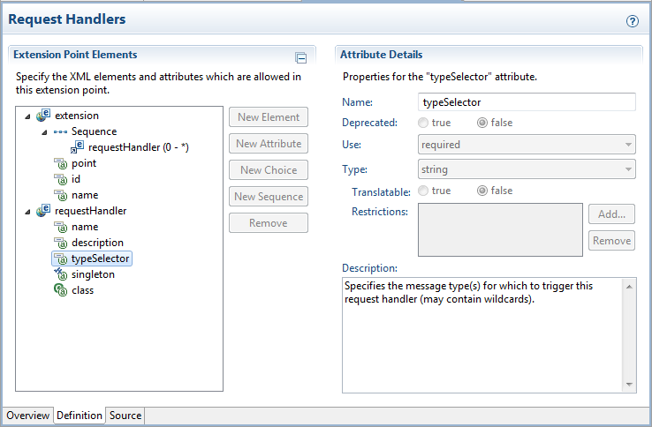
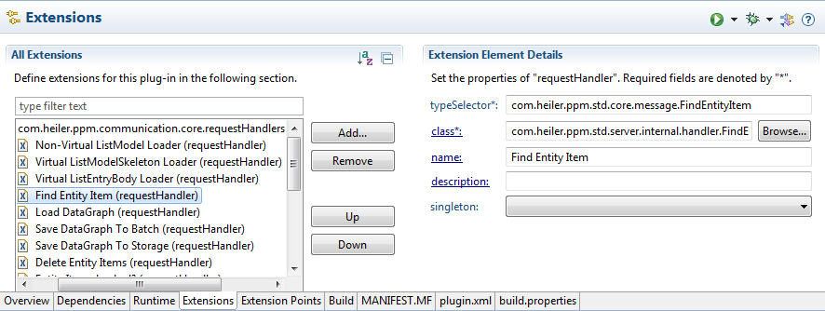
Extension point example – communication request handler
Extension point definition
Extension point contribution

Slide 43
Working with extensions
Extension registry can be programmatically accessed using IExtensionRegistry service
Extension point creator is responsible for extension contributions initialization
Using extensions one can contribute java classes (for example – some listener class contribution)
If a contributor class implements IExecutableExtension interface then it can access contribution attributes.

Slide 44
Working with extensions – communication handler example
Extension contribution
plugin.xml :
<plugin>
<extension
point="com.heiler.ppm.communication.core.requestHandlers">
<requestHandler
typeSelector="com.heiler.ppm.std.core.message.ListModelLoader"
class="com.heiler.ppm.std.server.internal.handler.ListModelLoader"
name="Non-Virtual ListModel Loader"/>
</extension>
</plugin>
Extension initialization:
//get extension registry using eclipse platform singletone
IExtensionRegistry reg = Platform.getExtensionRegistry();
IExtensionPoint extPoint = reg.getExtensionPoint( "com.heiler.ppm.communication.core.requestHandlers" );
IExtension[] extensions = extPoint.getExtensions();
IConfigurationElement[] elems = extensions[ 0 ].getConfigurationElements();
IConfigurationElement configElement = elems[ 0 ];
//Instantiate class contribution
RequestHandler handler = ( RequestHandler ) configElement.createExecutableExtension( "class" );
String selectorId = configElement.getAttribute( "typeSelector" );

Slide 45
Communication bus – HPM communication framework
Custom communication framework
Multiple servers with different roles
Load balancing, failover
Logical P2P network
One node may have many roles simultaneously
Node roles:
Client – client only, cannot accept requests
Client server – dispatch requests from clients
Primary/secondary controller – shared services for all nodes
Job server – server for batch jobs
File server – file storage server
Node
client
Node
client
Node
client
Node
client
Node
client
Network
Node
primary controller
Node
secondary controller
Node
client server
Node
job server
Node
file server

Slide 46
Communication – flows
Communication is message based
Node - marshal, route, enqueue and dispatch messages
Parties
Service invoker – synchronously sends a message and receives a response
Request handler – gets the message and handles the service logic
Event producer – asynchronously sends (broadcast) messages
Event handler – receives event and handle the listener logic
Communication bus
Request handler
Service invoker
Node
Request-response messages (sync)
Node
Send message
Handle message
Event messages (async broadcast)
Node
Event producer
Event handler
Event handler

Slide 47
Communication – send a message
// Build the request message
EasyMapMessage msg =
new EasyMapMessage( "com.heiler.ppm.configuration.server.message.GetServerPreference" );
msg.put( "pluginId", pluginId );
msg.put( "preferenceId", preferenceId );
msg.put( "defaultValue", defaultValue );
// Send the request
try
{
String value = ( String ) TheNode.getNode().sendRequest( NodeIdentifier.SERVER, msg );
return value;
}
catch ( CommunicationException e )
{
log.error( e.getLocalizedMessage(), e );
}

Slide 48
Communication – handle a message
public class GetServerPreference implements RequestHandler
{
public Object onMessage( RequestContext context, Message msg ) throws CoreException, InterruptedException
{
EasyMapMessage message = ( EasyMapMessage ) msg;
String preferenceId = message.getString( "preferenceId" ); //$NON-NLS-1$
String defaultValue = message.getString( "defaultValue" ); //$NON-NLS-1$
IPreferencesService service = Platform.getPreferencesService();
String value = service.getString( pluginId, preferenceId, defaultValue, null );
return value;
}
}
<plugin>
<extension
point="com.heiler.ppm.communication.core.requestHandlers">
<requestHandler
class="com.heiler.ppm.configuration.server.handler.GetServerPreference"
name="Get Server Preference"
singleton="false"
typeSelector="com.heiler.ppm.configuration.server.message.GetServerPreference"/>
</extension>
</plugin>

Slide 49
Communication – main classes
TheNode – platform singleton, holds the node instance
Node – communication node interface
NodeInfo – node runtime descriptor (identifier, roles, etc.)
NodeIdentifier – node identifier descriptor
Network – HPM logical network runtime descriptor (servers, clients, etc)
NodeListener – communication interceptor (request/response interceptor)
RequestHandler – request handler interface
Message and EasyMapMessage – message interfaces
EventListener – event listener interface

Slide 50
Components lifecycle management
HPM platform is using OSGi mechanisms to manage components dependencies and versions
OSGi bundle activators are NOT used (start() method is empty)
Platform services are initialized and started using Initializers
Initializers are called on startup by a PlatformContainer. Sequence is defined by RunLevel attribute of the contribution.
Initializer has also a counterpart – Disposer. Disposer is executed on shutdown.
<extension point="com.heiler.ppm.init.core.initializers">
<initializer
class="com.heiler.ppm.repository.internal.RepositoryValidator"
id="validate.repository"
start-level="PLATFORM_5">
</initializer>
</extension>

Slide 51
Initializer example
public class ConfigurationInitializer implements Initializer, Disposer
{
@Override
public void initialize( IProgressMonitor progressMonitor, StartupContext context ) throws CoreException, InterruptedException
{
LocalPreferenceService.theInstance = new LocalPreferenceService();
Activator.getContext()
.registerService( "org.eclipse.osgi.framework.console.CommandProvider",
new PreferenceCommandProvider(), null );
}
@Override
public void shutdown( IProgressMonitor progressMonitor ) throws CoreException, InterruptedException
{
LocalPreferenceService.getInstance()
.dispose();
LocalPreferenceService.theInstance = null;
}
}

Slide 52
Security – login token and impersonalization
Authentication. HPM supports internal and external authentication
Internal – user credential are stored in the HPM db (HPM security realm)
External – Windows Active directory using Kerberos
Every process in HPM runs in a security context of certain user defined by LoginToken
There are two predefined login tokens: GuestToken (anonymous) and SystemToken (has all permissions). SystemToken must never be used by application code!
Login token is created after successful authentication and transferred in every request
Every part of the platform which creates a thread also sets LoginToken on it using special ThreadLocal variable. This operation is called impersonalization.
If application developer create a new thread it must also call impersonalization for this thread
As of HPM 5.3 it is possible to call impersonalization for any user LoginToken (also SystemToken)

Slide 53
Impersonalization – code example
//Impersonator interface since 6.0
Impersonator impersonator = LoginManager.getInstance();
//Use the following pattern to switch security context to perform some actions.
LoginToken originalLoginToken = impersonator.getLoginToken();
impersonator.impersonate( someOtherLoginToken );
try
{
// do the work
}
finally
{
impersonator.impersonate( originalLoginToken );
}

Slide 54
Authorization - permissions
Authorization in HPM is controlled by Permissions which are bound to LoginToken
New types of permissions can by contributed using PermissionProviders extension point
Application developers must implement custom permission logic by themselves.
// check the article rights
LoginToken login = LoginManager.getInstance()
.getLoginToken();
Entity entity = RepositoryUtils.getRepositoryEntity( "Article" );
Permissions permissions = entity.getPermissions();
boolean hasArticleEditPermission = login.hasPermission( permissions.getEdit() );
boolean hasPermissionDeleteInPast = LoginManager.getInstance()
.getLoginToken()
.hasPermission( PriceConst.PERMISSION_PRICE_DELETE_IN_PAST );
<extension
point="com.heiler.ppm.security.core.permissionProviders">
<permissionProvider
class="com.heiler.ppm.articleprice.ui.internal.PricePermissionProvider"
name="Price UI"/>
</extension>

Slide 55
Preferences
Platform supports two different approaches of dealing with configuration values:
Server preferences defined in a *.properties file in the server „conf“ directory.
Defines configuration properties which are environment specific, i.e. required to be set in order to run HPM server (file paths, network addresses, database names, etc)
The main file is server.properties
Application developers may create thier own configuration files
Property value may reference to another property like this: myproperty = my${anotherProperty}
Plugin preferences defined in the preferences.ini file a plugin root folder
Backed by Eclipse Preference Service
Preferences have plugin scope
Defines prefernces related to application behavior. Must not contain environment specific values
Preferences can be overridden in the plugin_customization.ini file which is located under server/client conf folder
See Eclipse documentation for more details
It is important to choose correct preferences approach!

Slide 56
Working with preferences
//works in all contexts: client, core and server
//get preference value defined in the server.properties
String destHost = Environment.getConfigValue( "dest.host" );
//get plugin preference
IPreferencesService service = Platform.getPreferencesService();
String prefValue = service.getString( Activator.getContext()
.getBundle()
.getSymbolicName(), “my.preference.name", "", null );
//get a dynamic preference
String dynamicPrefValue = LocalPreferenceService.getInstance().
getPreference( "plugin.name", "myPreference");
//get plugin preference from server plugin
PreferenceUtil.getServerPreference( "serverplugin.name", "myPreference", null );

Slide 57
Working with preferences (custom properties file)
//load custom properties file
//create full qualified properties file
File file = new File(
ConfigurationUtils.getConfigurationDir(), "myCustomConfFile.properties" );
FileInputStream is = new FileInputStream( file );
Properties props = new Properties();
Try
{
//load properties
props.load( is );
//resolve all references properties in the file, i.e. replace ${otherprop}
ConfigurationUtils.configureProperties( props );
}
finally
{
is.close();
}

Slide 58
XML Serialization
Store and load platform and application objects in XML format. Typical example: user profile configuration object which need to be saved across user sessions.
It is not domain objects persistence
It is not HPM communication framework marshaling
All main platform objects support xml serialization and it can be used by XML serialization of custom container classes.
Application is responsible for writing/reading xml structure using provided dom4j tools.
Framework provided by HPM platform:
DomPersistable2 interface. Classes must implement writeToDom(…) method to convert (serialize) to XML.
DomPersistableFactory interface. Classes must implement createFromDom() method to create objects from XML structures
com.heiler.ppm.xml.domPersistableFactories extension point to contribute domPersistableFactories.
Deprecated but still used frameworks:
DomPersistable, PersistableElement

Slide 59
XML Serialization – example DomPersistable2
public class MyConfig implements DomPersistable2
{
private String myName;
private ReportResult reportResult;
public MyConfig( String myName, ReportResult reportResult )
{
this.myName = myName;
this.reportResult = reportResult;
}
@Override
public String getFactoryId()
{
return Factory.IDENTIFIER;
}
@Override
public void writeToDom( DomPersistWriteContext context, Element anchorElement ) throws Exception
{
//same name as xml attribute
anchorElement.addAttribute( "myName", this.myName );
//save report under <myReport>...</myReport>
context.writeToDom( this.reportResult, anchorElement.addElement( "myReport" ) );
}

Slide 60
XML Serialization – example DomPersistableFactory
public static final class Factory implements DomPersistableFactory
{
public static final String IDENTIFIER = "hlr.me.MyConfig"; //$NON-NLS-1$
@Override
public Object createFromDom( DomPersistReadContext context, Element anchorElement ) throws
Exception
{
String myName = DomPersistUtils.getAttributeValue( anchorElement, "myName", true, null );
Element reportXmlElement = anchorElement.element( "myReport" );
ReportResult reportResult = context.createFromDom( reportXmlElement );
return new MyConfig( myName, reportResult );
}
}
<extension
point="com.heiler.ppm.xml.domPersistableFactories">
<factory
class="com.heiler.ppm.me.MyConfig$Factory"
id="hlr.me.MyConfig">
</factory>
</extension>

Slide 61
I18N
Eclipse I18N support is not used because it is not able to handle multiple locales in runtime
Every thread in HPM platform has its own locale defined in the ThreadLocale singleton
ThreadLocale is switched to LoginToken locale on impersonalization
Messages must be defined in a messages.properties file
Message values must be access using MessagesHelper
Messages may contain place holders. Such messages must be resolved using MessagesUtils

Slide 62
I18N – messages example
LoginManager.userOrPasswordWrong = Login failed.\r\nThe user name or password is incorrect.
LoginManager.wrongDomain = Login failed.\r\nThe saved domain ({0_systemDomain}) does not match that of the operating system user ({1_OSdomain}).
abstract class Messages
{
private static final String BUNDLE_NAME = "com.heiler.ppm.security.core.messages";
private static final MessagesHelper messagesHelper
= new MessagesHelper( BUNDLE_NAME, Messages.class );
public static String getString( String key )
{
return messagesHelper.getString( key );
}
}
String msg = Messages.getString( "LoginManager.userOrPasswordWrong" );
String msg = Messages.getString( "LoginManager.wrongDomain" );
msg = MessagesUtils.replace( msg, false, domain, ticketDomain );

Slide 63
DB access
Usually is not neccessary from the application code!
Universal Data Access (UDA) – JDBC facade to call Stored Procedures in a DB agnositc way
Use PersistenceLayer.getContext().getUDA() to get UDA service
Java Persistence API (JPA) EnityManager – can be used to run HQL queries.
PersistenceLayer.getContext().getDataSourceRegistry().aquireManager(…)
PersistenceLayer.getContext().getDataSourceRegistry().releaseManager(…)
HPM Data sources – predefined databases (MASTER, MAIN, SUPPLIER).

Slide 64
Logging
Logging – log4j. Loggers are configured in the log4j.xml which is located in the conf folder.
Use if/else if you concatenate strings in the TRACE or DEBUG messages
private static Log log = LogFactory.getLog( SomeMyLogging.class );
…
if ( log.isDebugEnabled() )
{
String msg = "Used generic entity manager implementation (EntityManagerImpl) for entity type: " + entityTypeIdentifier;
log.debug( msg );
}

Slide 65
Caching
Caching – Ehcache. Caches are configured in the ehcache.xml which is located in the conf folder.
CacheManager cacheManager = CacheManager.getInstance();
this.intern2externCacheName ="proxy.ArticleType.int2ext"; //$NON-NLS-1$
//cache can be already configured in the external config
if ( !cacheManager.cacheExists( this.intern2externCacheName ) )
{
Cache intern2extern = new Cache( this.intern2externCacheName, 100000, false, true, 5, 2 );
cacheManager.addCache( intern2extern );
}
this.intern2externCache = cacheManager.getCache( this.intern2externCacheName );
<cache
name="proxy.ArticleType.int2ext"
maxElementsInMemory="1000000"
eternal="true"
timeToIdleSeconds="120"
timeToLiveSeconds="120"
overflowToDisk="false"
maxElementsOnDisk="10000000"
diskPersistent="false"
diskExpiryThreadIntervalSeconds="120"
memoryStoreEvictionPolicy="LRU"
/>

Slide 66
Monitoring
Java managed beans (JMX) is used for internal management and monitoring
Beans will be registered in the managed beans server under „com.heiler.ppm“ category
Hashtable< String, String > reportStatisiticsBeanProperties =
ManagementService.getInstance().
createBeanProperties( "reporting", "reportHandlerStatistics" );
ManagementService.getInstance()
.registerManagementBean( reportStatistics, reportStatisiticsBeanProperties );

Slide 67
Application services

Slide 68
GUI

Slide 69
HPM Platform internals

Slide 70
Topics that are not yet covered here
Enumerations (EnumProvider)
EntityItemList, EntityReport
Repository API. Repository Utils.
Validation
List model access examples
CommadFramework examples
WebServices and REST services contribution
IValue and IValueProvider
Lock service
Stateless communication
Where is the business model (PPMPackage Builder)
DetailModel Filter
Virtual list models (arch), performance
Functions
Entity package (Entity Report, Entity Report Query)
HPM Commons
Class registry
Relation handler framework
Converters

